Slide 1
Marketing Analytics Mahmoud Nasr

Slide 2
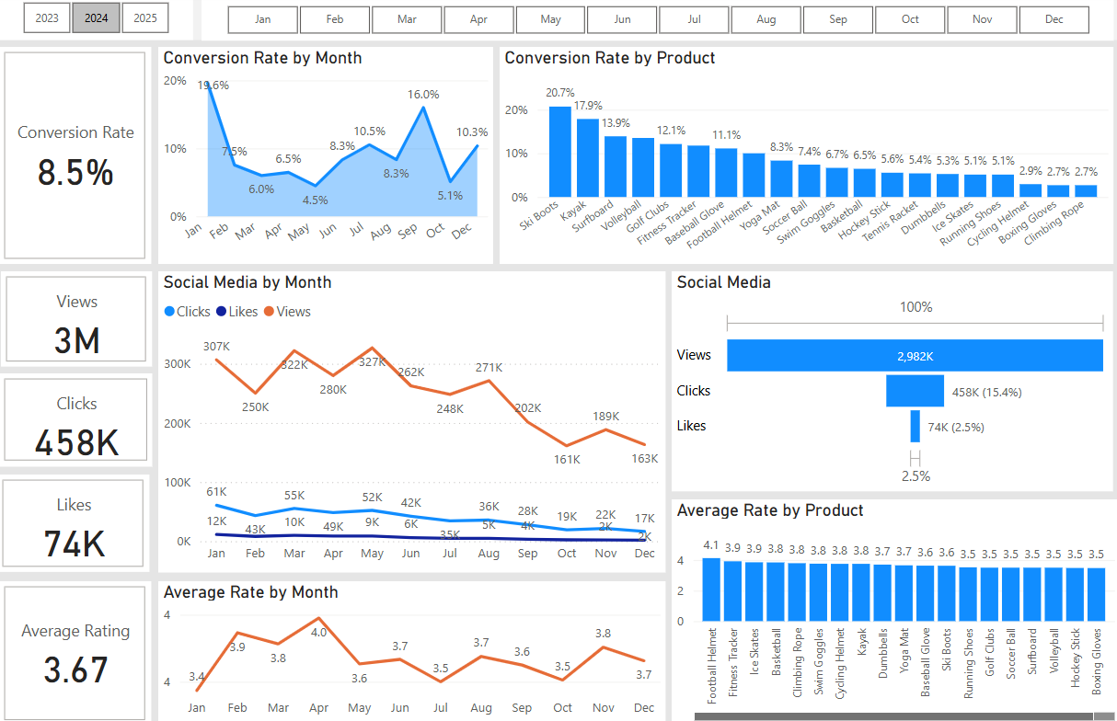
Overview
Decreased Conversion Rate:
Conversion rate started at 19.6% in Jan, which might be caused by the new year season, then strongly declined during the next two months and fluctuated until increased to reach 16.0% in Sep.
The average Conversion rate throughout the year was 8.5%.
Management needs to focus on month with a conversion rate under the average(the area shaded in light blue in the line graph).
Improve the conversion rate for the products under the average conversion rate.
Decreased Customer Engagement:
The number of customers who visited the site started around 307K in Jan then fluctuated until declined sharply in Oct.
Throughout the year, 15.4% of about 3M engaged customers interacted by clicks, while only 2.5% did like.
Customer Feedback:
Customer ratings have remained around 3.7 on average throughout the year, which is under the target rate of 4.0.
The marketing plan should focus on improving the customer satisfaction for products rating under the average.

Slide 3
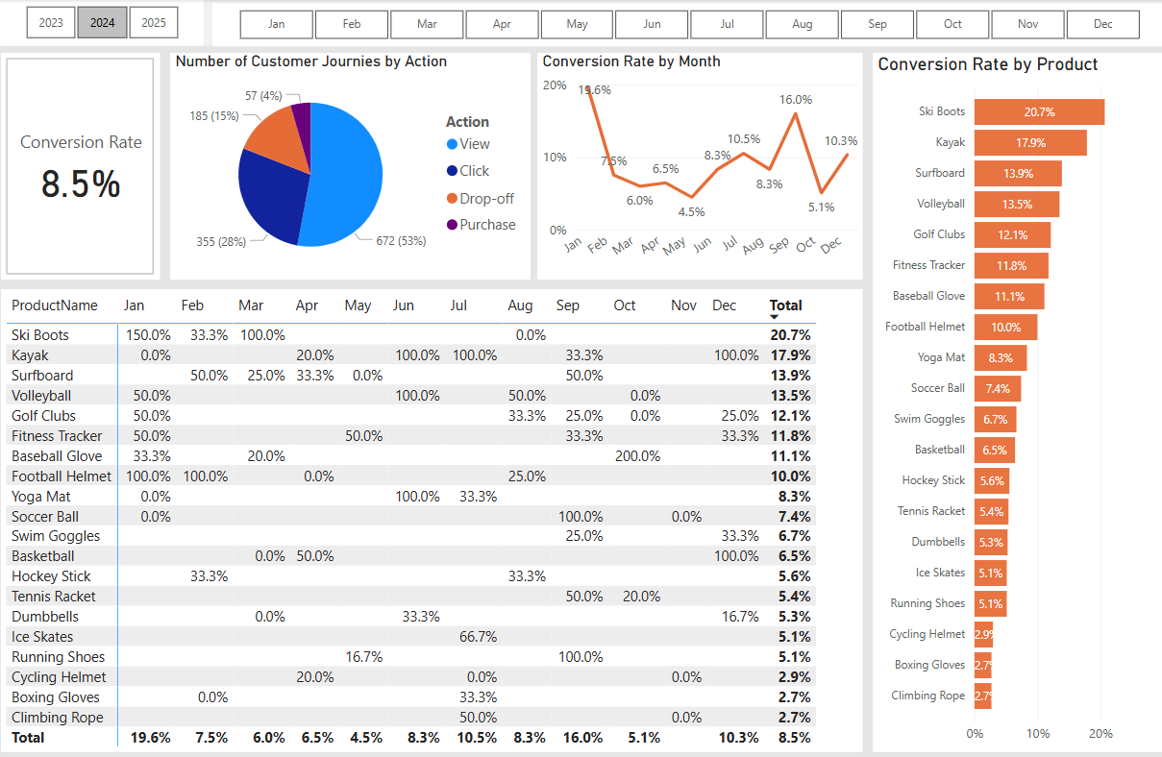
Decreased Conversion Rate
Conversion Rate Over Months:
There was a fluctuation in conversion rate throughout the year 2024 with an overall average of 8.5%.
It started at 19.6% in Jan, probably because of new year season, then strongly declined to 7.5% in Feb
The lowest conversion rate was in May.
Customer Journey by Action:
Of 1,269 customer journeys, only 4% was translated to purchase action.
There was 15% drop-off : indicates the need to identify customer pain points and understand where customers drop off or face friction.
That might suggest create tailored messaging for different customer journey stages.
Conversion Rate by Product:
Even during months with high conversion rate, the were some products with very poor conversion rates.
The pain points might be:
Abandoned carts because of unexpected shipping costs or complicated checkout process.
Low trust in product quality because of no reviews or ne clear warranty/return policy.
There is no clear guidance or comparison tool for the product.
Suggested solutions:
Show transparent pricing , offer free shipping thresholds or display trust badges (money-back guarantee)
Add testimonials from real customers.

Slide 4
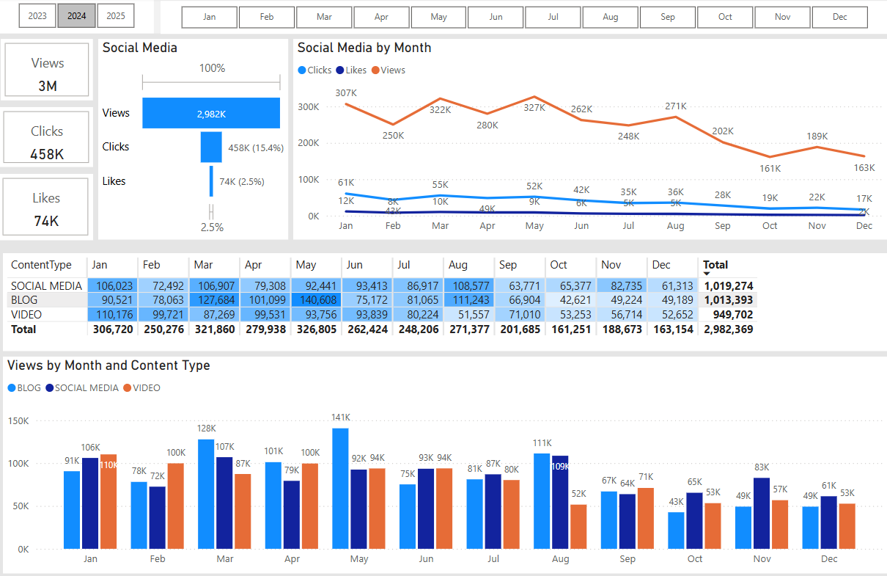
Reduced Customer Engagement
Views Trend:
There was a peak in views in March and May, where as the number varied during other months with the lowest numbers of views during the third quarter.
Low Interaction Rates:
Of the 3M views in 2024, there were only 458K(15.4%) of clicks and 74K(2.5%) likes.
Clicks and likes remained consistently low compared to views, suggesting the need for more engaging content or stronger calls to action.
Content Type Performance:
Social media and Blog content drove the most views, especially in Mar, May, and Aug, while video content maintained lower engagement.

Slide 5
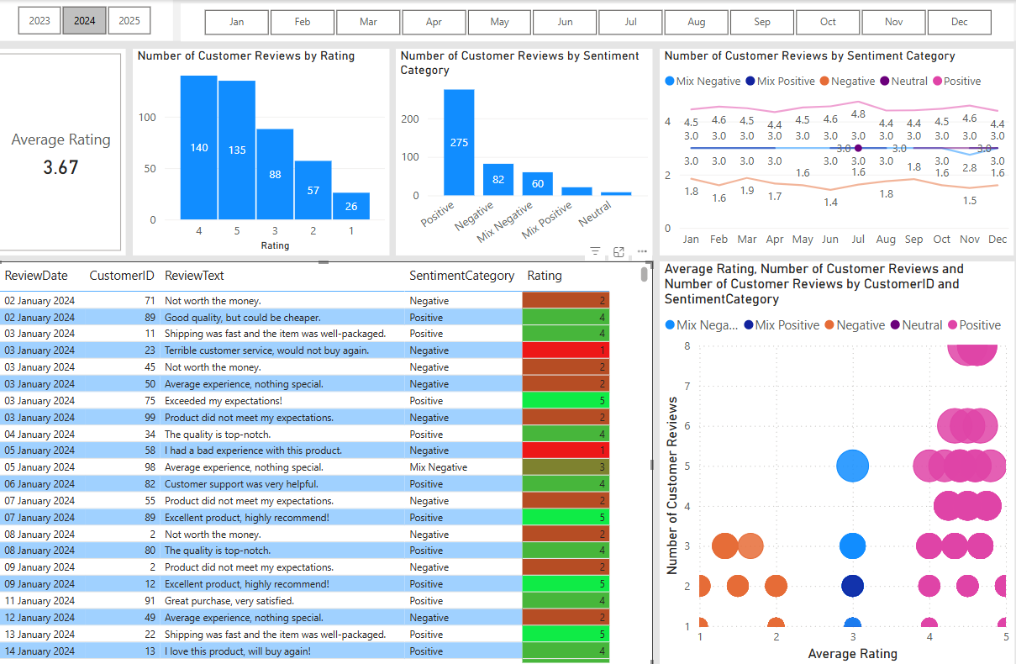
Customer Feedback Analysis
Customer Ratings Distribution:
The majority of customer reviews are in the higher ratings, with 140 reviews at 4 stars and 135 reviews at 5 stars, indicating overall positive feedback. Lower ratings (1-2 stars) account for a smaller proportion, with 26 reviews at 1 star and 57 reviews at 2 stars.
Sentiment Analysis:
Positive sentiment dominates with 275 reviews, reflecting a generally satisfied customer base. Negative sentiment is present in 82 reviews, with a smaller number of mixed and neutral sentiments, suggesting some areas for improvement.
Opportunity for Improvement:
The presence of mixed positive and mixed negative sentiments suggests that there are opportunities to convert those mixed experiences into positive ones, potentially boosting overall ratings. Addressing the specific concerns in mixed reviews could elevate customer satisfaction.

Slide 6
Goals & Actions
Goals
Increase Conversion Rates:
Goal: Identify factors impacting the conversion rate and provide recommendations to improve it.
Insight: Highlight key stages where visitors drop off and suggest improvements to optimize the conversion funnel.
Enhance Customer Engagement:
Goal: Determine which types of content drive the highest engagement.
Insight: Analyze interaction levels with different types of marketing content to inform better content strategies.
Improve Customer Feedback Scores:
Goal: Understand common themes in customer reviews and provide actionable insights.
Insight: Identify recurring positive and negative feedback to guide product and service improvements.
Actions
Increase Conversion Rates:
Target High-Performing Product Categories:
Focus on products demonstrating high conversion rates, such as Ski Boots, and Kayak.
Implement seasonal promotions during peak months (e.g., Mar and May) to capitalize on these trends.
Enhance Customer Engagement:
Review Content Strategy:
Double down on high-engagement channels.
Fix or drop underperforming content.
Try new formats (e.g., YouTube tutorials).
Post behind-the-scenes content (e.g., “How we test our products.”)
Boost engagement by optimizing call-to-action placement in social media and blog content, particularly during lower-engagement months (Oct-Dec).
Improve Customer Feedback Scores:
Address Mixed and Negative Feedback:
Implement a feedback loop where mixed and negative reviews are analyzed to identify common issues. Develop improvement plans to address these issues.
Consider following up with dissatisfied customers to resolve issues.

